Slide 1
Overview
Security, Privacy, and Consumer Protection Nick Feamster University of Chicago

Slide 2
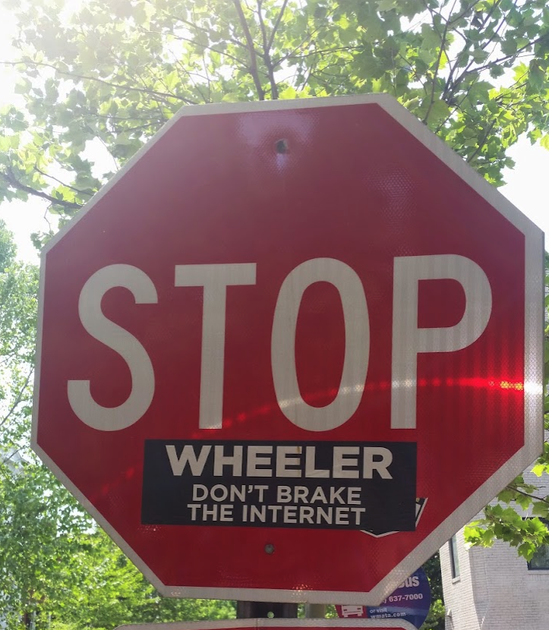
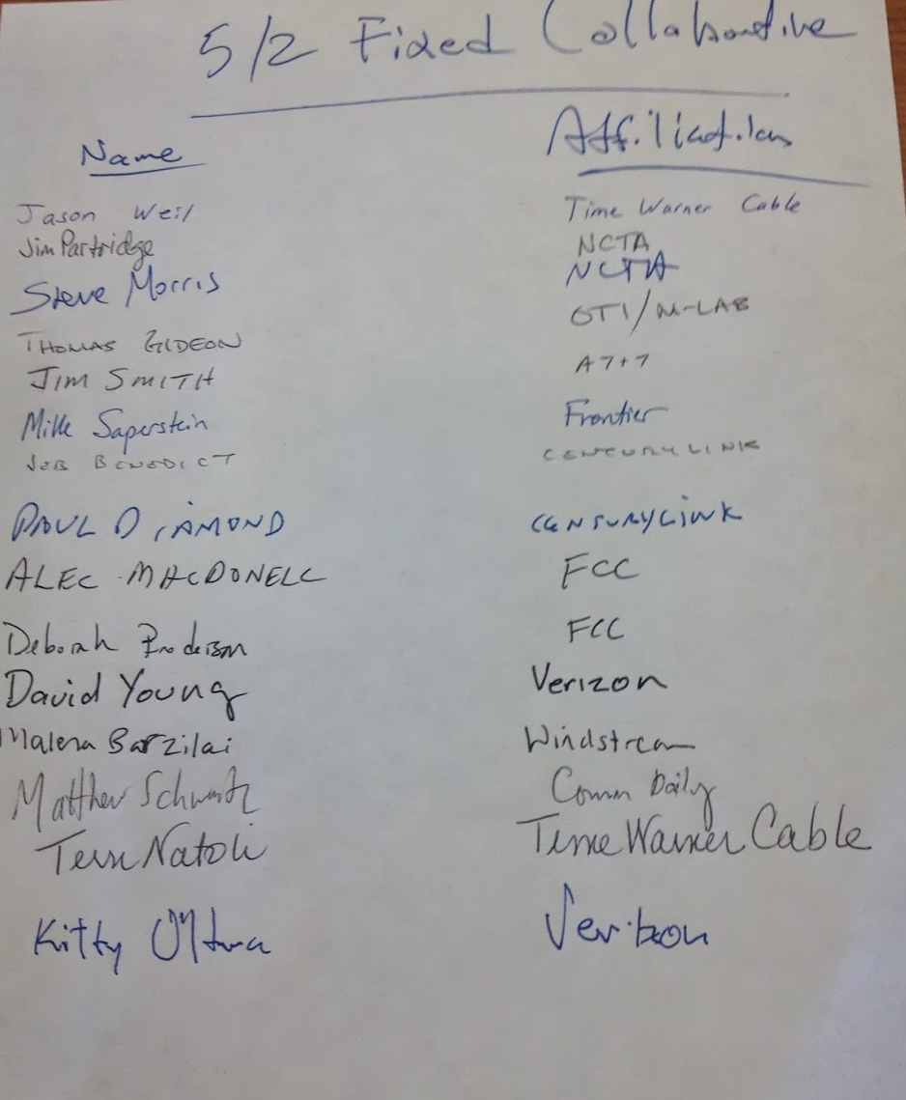

Slide 3
There is a dearth of technologists in public policy arenas. Let’s change that!

Slide 4
Agenda
Who am I?
Learning objectives
Course syllabus and components
Readings (+ possible quizzes)
Lectures
Midterm/Final (on Fridays, in class; and/or take-home, TBD)
Lab/Problem sets
Debates (~ 4 people / debate, four this term)

Slide 5
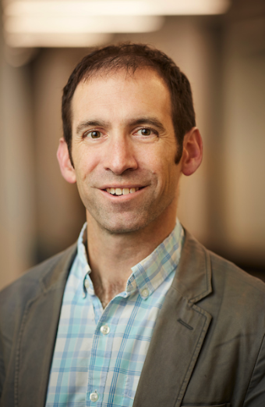
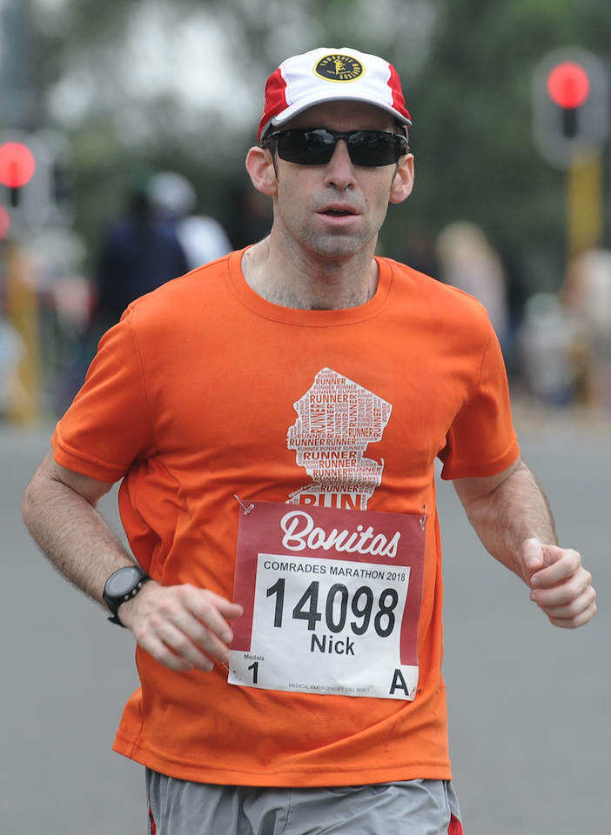
Who Am I?
Professor Nick Feamster
My Research Area: Computer Networking and Security
Applications of Machine Learning (anomaly detection, classification)
Applications to Public Policy (broadband deployment, digital divide, …)
Past policy engagement
Broadband Internet Tech Advisory Group (https://bitag.org/)
Testimony at Federal Trade Commission, NJ State Legislature (net neutrality)
Presentations to FTC CTO
Comments to FCC, USPTO, …
Less past engagement at state, municipal levels, less data-driven policy work, which is part of why I wanted to come to University of Chicago!

Slide 6
Learning Objectives
This course will cover the principles and practice of security, privacy, and consumer protection. Topics include: basic cryptography; physical, network, endpoint, and data security; privacy (including user surveillance and tracking); attacks and defenses; and relevant concepts in usable security. The course will place fundamental security and privacy concepts in the context of past and ongoing legal, regulatory, and policy developments, including: consumer privacy, censorship, platform content moderation, data breaches, net neutrality, government surveillance, election security, vulnerability discovery and disclosure, and the fairness and accountability of automated decision making, including machine learning systems. Students will learn both technical fundamentals and how to apply these concepts to public policy outputs and recommendations.

Slide 7
Is this course for you?
You are comfortable programming (or know someone in the class who is). This is not a programming-heavy class, but programming will be useful. (Hence, pre-requisites/approval.)
You should have an interest in tech policy, and/or developing those skills.
You should have an interest in conveying technical ideas through verbal communication (written, spoken).

Slide 8
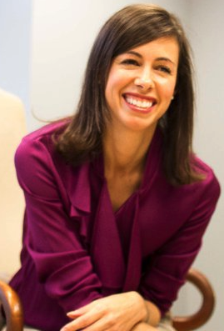
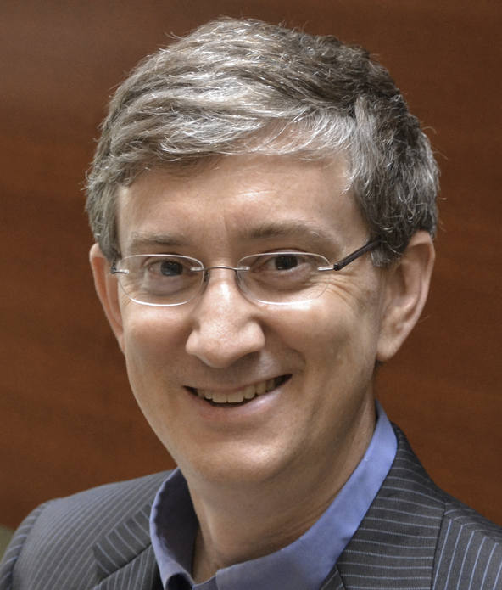
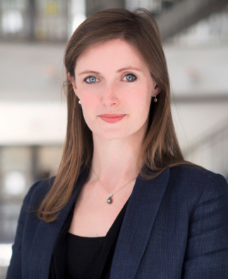
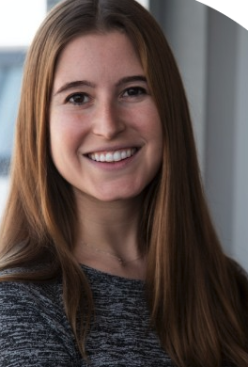
Possible Career Paths
FTC CTO, US Deputy CTO (and Princeton Professor)
FCC Commissioner
CEO, Civil Society NGO
Data Scientist, City of Chicago

Slide 9
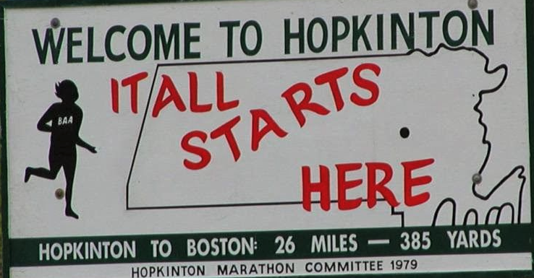
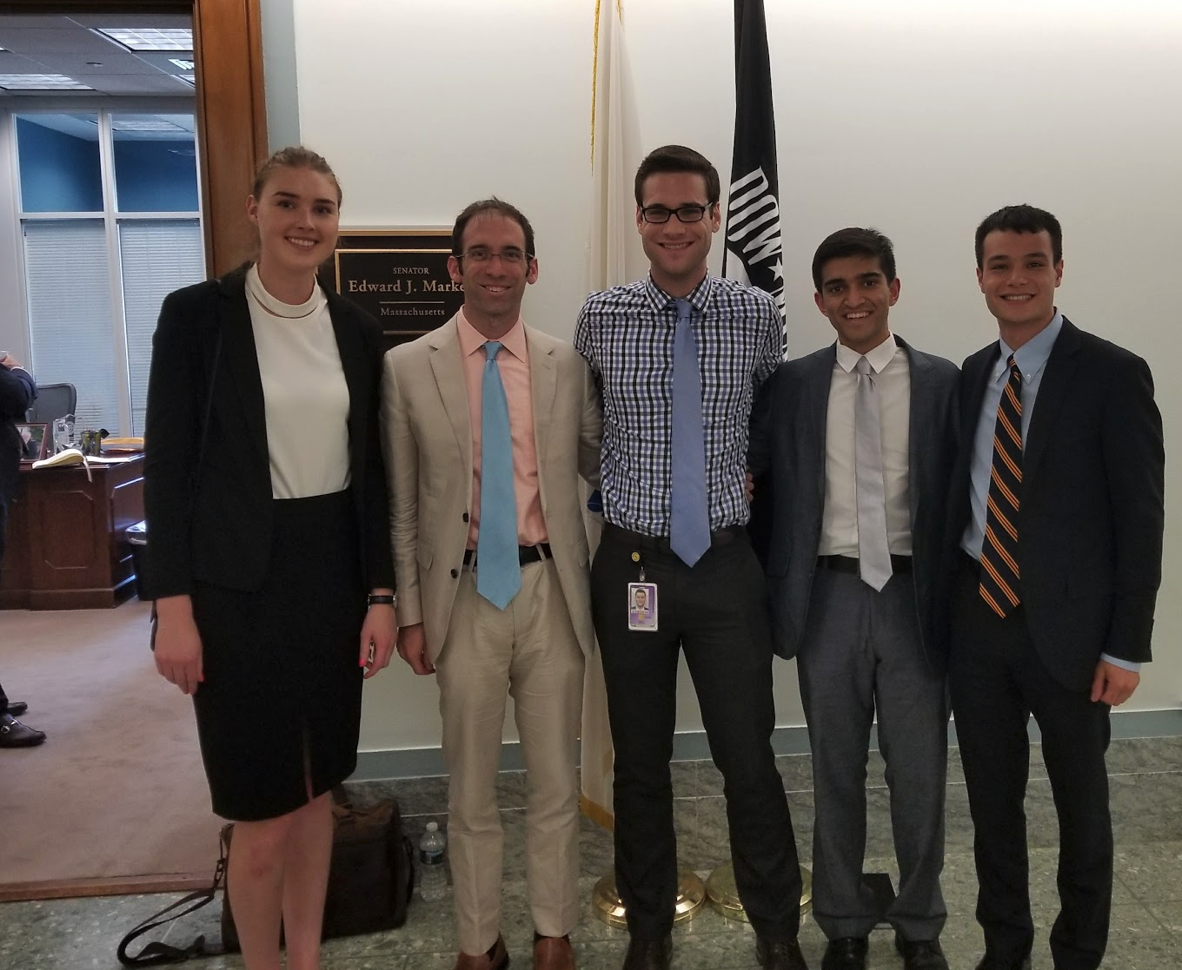
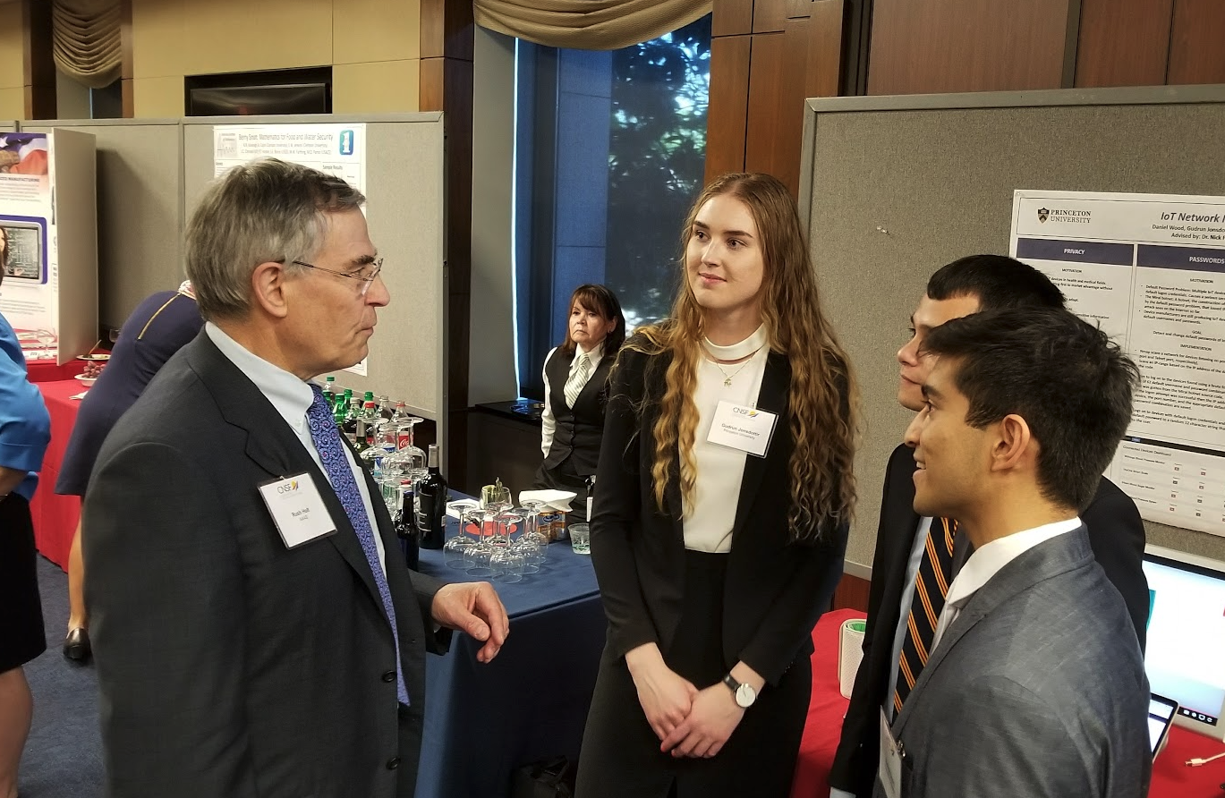

Slide 10
Readings
Everything will be posted to Canvas the week before the following week (ideally, Friday).
If it is not excerpted on Canvas you are not responsible for it (e.g., you don’t have to read entire [text]books)
Come to class having read (potentially some short pop quizzes for accountability!)

Slide 11
(Rough) General Lecture Organization
50 minutes: 3:30 – 4:20 p.m.
5-10 minutes: Vignette related to reading
20 minutes: Key idea for the day
5 minutes: Thought question and breakout
10 minutes: Discussion

